Slide 1


Calabash-android
workshop
Lesson 8: Work with Selenium under Calabash-android.

Slide 2
Selenium
Selenium is a suite of tools to automate web browsers across many platforms.
http://docs.seleniumhq.org/

Slide 3
Configure to work with Calabash-android
Install gem:
gem install selenium
gem install selenium-webdriver
Attach requirements to step definition file:
require 'rubygems'
require 'selenium-webdriver'

Slide 4
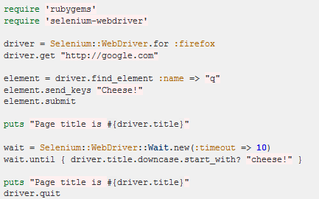
Selenium - Ruby

Slide 5
UI elements in WebSite and Android
<input id="input" type="text" />
EditText
<label>MyLabel</label>
TextView
<select id="select"><option value=”A”>option1</option></select>
Spinner
<button type=”button”>mybutton</button>
<input id="button" type="submit"/>
Button
<input id="mycheckbox" type="checkbox" />
CheckBox

Slide 6
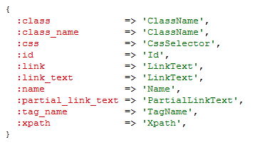
Finding elements
Example:
driver.find_element(:id => 'myButton')

Slide 7
Documentation:
http://docs.seleniumhq.org/docs/
http://rubydoc.info/gems/selenium-webdriver/

